Slide 1
Testing Process-Round2

Slide 2
Testing Timeline
Testing & Feedback
Phase 1:
Due Wednesday 2/14
Programmer fixes bugs and
Responds to Feedback:
Monday 2/19
Testing and Feedback
Phase 2:
Due 2/26
Programmer fixes bugs and
Responds to Feedback:
Monday 3/2
Final Look
Over/
Feedback
(3/2-3/3)
Completed
Product

Slide 3
Phase 2
Phase 1 testing is due next Monday, Feb 26
This phase is checking the math the script is calculating. This is detail oriented.
Can be completed in 3-4 hours

Slide 4
Phase 2 Testing Questions
Contains all of the questions from phase 1
You will be selecting 2 teachers to check the math by hand and time in/out by hand.

Slide 5
Examples of Errors
These were Hand-Made errors for Explanations

Slide 6
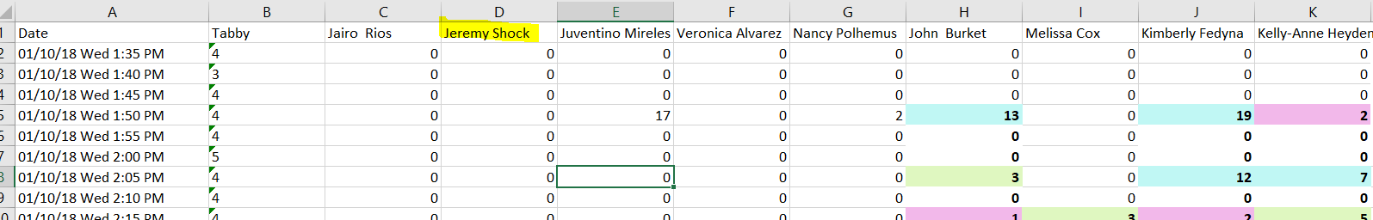
Are all of the teachers on your team?(Jairo’s workbook)

Slide 7
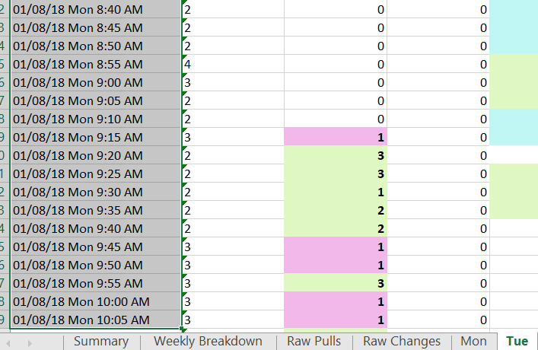
Are all of the Dates Correct?
This is a Tuesday worksheet
But it is showing Monday’s data.

Slide 8
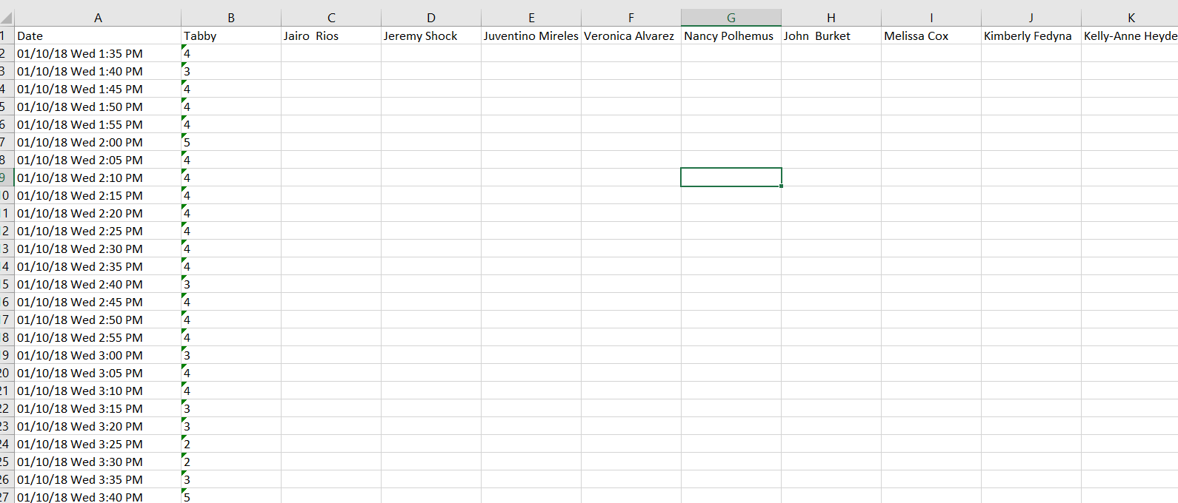
Are you missing a days worth of data (blank/partly blank/missing spreadsheets)

Slide 9
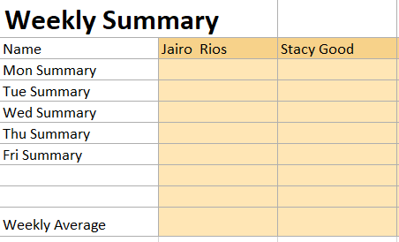
Obvious schedule issues (A teacher was in PZ on a day they were suppose to be off? Do you have teachers working on the weekends?)
Jairo is a full time lead. He should not have a Saturday worksheet.
Jairo checked shiftboard and saw that both he and Stacy had worked this week. There should be data here.

Slide 10
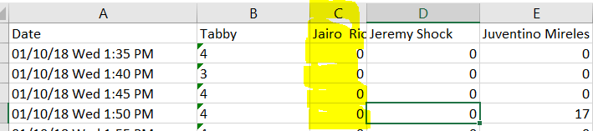
Do you have consistent columns width?(Jair’s workbook)

Slide 11
How to Fill in Testing Excel Sheet

Slide 12
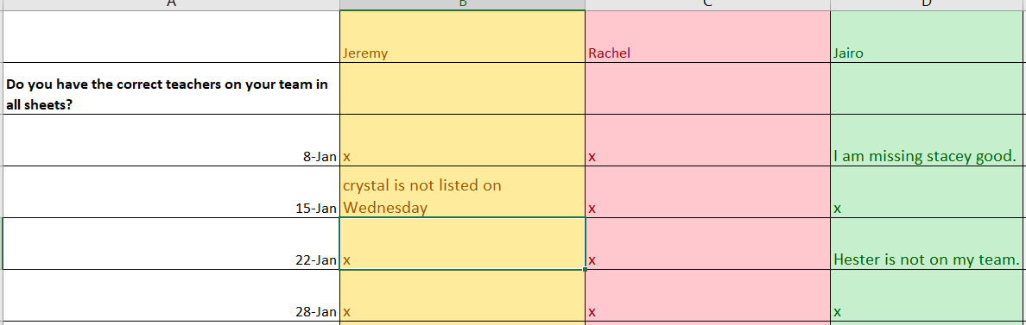
Step 1: Open up workbook
Step 2: Look through all worksheets for first question, (Do I have all of my teachers?).
Step 3: If there is nothing wrong, just put an x. If there is an issue, list it out in the excel sheet.
Step 4: Repeat for all questions for ALL workbooks.
Here is an example image of what it could look like.

Slide 13
Suggestions and My Feedback
The last column is for my feedback. Most of the time my feedback will be “fixed” to the problems you listed.
The biggest benefit of two phases for testing is it allows me to implement any suggestions you may have. At the bottom of the testing sheet, I left room for suggestions.
Please place each on their own cell, so I can go through them one by one, like a check list.
Make them as detailed as you like. You can even make mock-ups and snip them and place them in the worksheet! Just make sure you reference the location of you picture in the suggestion.

Slide 14
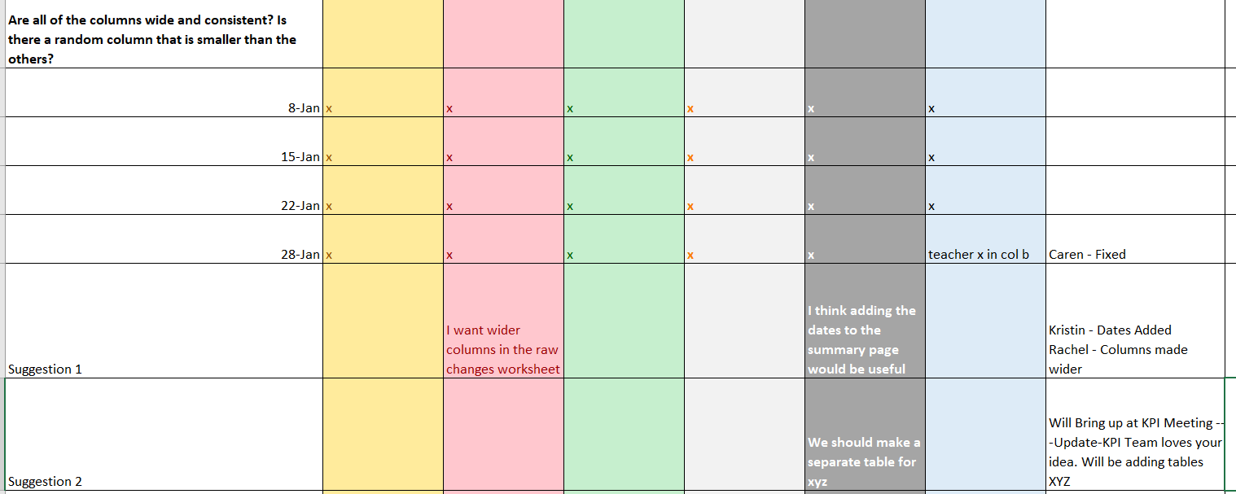
example
My Feedback
Column

